Slide 1

VIETNAM NATIONAL UNIVERSITY – HO CHI MINH CITY
UNIVERSITY OF INFORMATION TECHNOLOGY
DS307
SOCIAL MEDIA ANALYSIS
Faculty of Information Science and Engineering
University of Information Technology, VNU-HCM
UIT, VNU-HCM
Social Media Analysis

Slide 2
This Course’s Contents
  Introduction to Information Retrieval
UIT, VNU-HCM
Social Media Analysis

Slide 3

Why Study IR?
Many reasons, but if you want a one-word answer:
UIT, VNU-HCM
Social Media Analysis

Slide 4
Google …
  Examines billions of web pages
  Returns results in less than half a second
  Valued at gazillions of dollars by the public market
UIT, VNU-HCM
Social Media Analysis

Slide 5
How Does Google Work?
  Only Google know, but . . .
  Uses hundreds of thousands of machines
  Uses some sophisticated computer science (efficient storage and searching of large datasets)
  Uses an innovative ranking algorithm
  (based on the hypertext structure of the web)
UIT, VNU-HCM
Social Media Analysis

Slide 6
How Does Google Work?
  Underlying Google is basic IR technology.
  The Web is indexed.
    an index links terms with pages.
  A user’s information need is represented as a query.
  Queries are matched against web pages.
    Google attempts to return pages which are relevant to the information need.
UIT, VNU-HCM
Social Media Analysis

Slide 7
IR is More Than Web Search
  IR is much older than the Web (1950s –)
  The Web has some unique characteristics which make it a special case.
  IR deals with tasks other than searching:
    Categorizing Documents.
    Summarizing Documents.
    Answering Questions.
    …
UIT, VNU-HCM
Social Media Analysis

Slide 8
Motivation for IR
  Searching literature databases.
  Web search.
  Volume of information stored electronically is growing at ever faster rates
    need to search it
    categorize it
    filter it
    translate it
    summarize it
    ...
UIT, VNU-HCM
Social Media Analysis

Slide 9
Biomedical Information
  Biomedical literature is growing at a startling rate
    Around 1,000,000 new articles are added to Medline each year
  Tasks:
    Literature search
    Creation and maintenance of biological databases
    Knowledge discovery from text mining
UIT, VNU-HCM
Social Media Analysis

Slide 10
Document Retrieval
IR is often used to mean Document Retrieval
Primary task of an IR system:
retrieve documents with content that is relevant to a user’s information need
How do we represent content?
How do we represent information need?
How do we decide on relevance?
UIT, VNU-HCM
Social Media Analysis

Slide 11
Document Retrieval
Representation/Indexing
  Representation of documents and requests:
    bag of words?
    stop words, upper/lower case, . . . ∗
    query language
  Storing the documents, building the index
Searching
  Is a document relevant to the query?
    models of IR: Boolean, vector-space, probabilistic
  Efficient algorithms for searching large datasets
UIT, VNU-HCM
Social Media Analysis

Slide 12
What IR is Not
An IR system is not a Database Management System
A DBMS stores and processes well-defined data
A search in a DBMS is exact / deterministic
Search in an IR system is probabilistic
  inherent uncertainty exists at all stages of IR: information need, formulating query, searching
UIT, VNU-HCM
Social Media Analysis

Slide 13
A Simple Retrieval Model
Bag of Words approach
  A document is represented as a bag of words – Word order is ignored
  Syntactic structure is ignored
  ...
Relevance is determined by comparing the words in the document with the words in a query
Simple approach has been very effective
UIT, VNU-HCM
Social Media Analysis

Slide 14
Vector Space Model
Provides a ranking of documents with respect to a query
Documents and queries are vectors in a multi-dimensional information space
Key questions:
  What forms the dimensions of the space? ∗ terms, concepts, . . .
  How are document and query vectors compared?
UIT, VNU-HCM
Social Media Analysis

Slide 15
Coordinate Matching
Document relevance measured by the number of query terms appearing in a document
Terms provide the dimensions
  Large vocabulary ⇒ high dimensional space
Similarity measure is the dot-product of the query and document vectors
UIT, VNU-HCM
Social Media Analysis
Notes:
Length along a dimension is either 0 or 1

Slide 16
Simple Example
Term vocabulary: (England, Australia, Pietersen, Hoggard, run, wicket, catch, century, collapse)
Documents:
  d1: Australia collapse as Hoggard takes 6 wickets
  d2: Pietersen’s century puts Australia on back foot
Queries:
  q1: {Hoggard, Australia, wickets}
Query, document similarity
  q1.d1 = (0,1,0,1,0,1,0,0,0) · (0,1,0,1,0,1,0,0,1) = 3
  q1.d2 = (0,1,0,1,0,1,0,0,0) · (0,1,1,0,0,0,0,1,0) = 1
UIT, VNU-HCM
Social Media Analysis

Slide 17
Term Frequency (TF)
Coordinate matching does not consider the frequency of query terms in documents
Term vocabulary: (England, Australia, Pietersen, Hoggard, run, wicket, catch, century, collapse)
d1: Australia collapsed as Hoggard took 6 wickets. Flintoff praised Hoggard for his excellent line and length.
q1: {Hoggard, Australia, wickets}
q1 · d1 = (0,1,0,1,0,1,0,0,0) · (0,1,0,2,0,1,0,0,1) = 4
UIT, VNU-HCM
Social Media Analysis

Slide 18
Term Frequency (TF)
Coordinate matching does not consider the number of documents query terms appear in
Term vocabulary: (England, Australia, Pietersen, Hoggard, run, wicket, catch, century, collapse)
d2: Flintoff took the wicket of Australia’s Ponting, to give him 2 wickets for the innings and 5 wickets for the match.
q1: {Hoggard, Australia, wickets}
q1 · d2 = (0,1,0,1,0,1,0,0,0) · (0,1,0,0,0,3,0,0,0) = 4
UIT, VNU-HCM
Social Media Analysis

Slide 19
Inverse Document Frequency (IDF)
Assume wicket appears in 100 documents in total, Hoggard appears in 5, and Australia in 10
(ignoring IDF of other terms)
d1: Australia collapsed as Hoggard took 6 wickets. Flintoff praised Hoggard for his excellent line and length.
d2: Flintoff took the wicket of Australia’s Ponting, to give him 2 wickets for the innings and 5 wickets for the match.
q1: {Hoggard, Australia, wickets}
q1 · d1 = (0,1,0,1,0,1,0,0,0) · (0,1/10,0,2/5,0,1/100,0,0,1) = 0.411
q1 · d2 = (0,1,0,1,0,1,0,0,0) · (0,1/10,0,0/5,0,3/100,0,0,0) = 0.13
UIT, VNU-HCM
Social Media Analysis

Slide 20
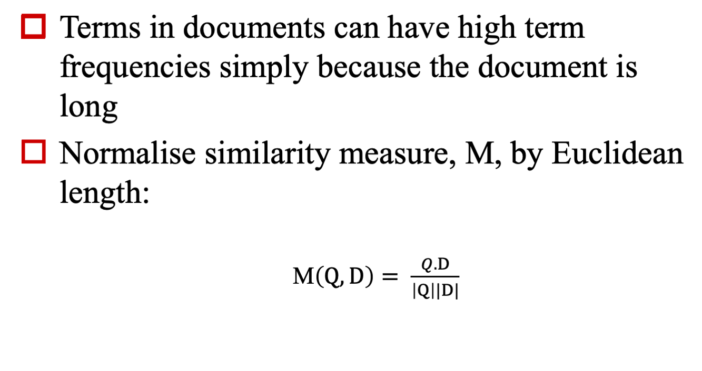
Document Length
UIT, VNU-HCM
Social Media Analysis

Slide 21
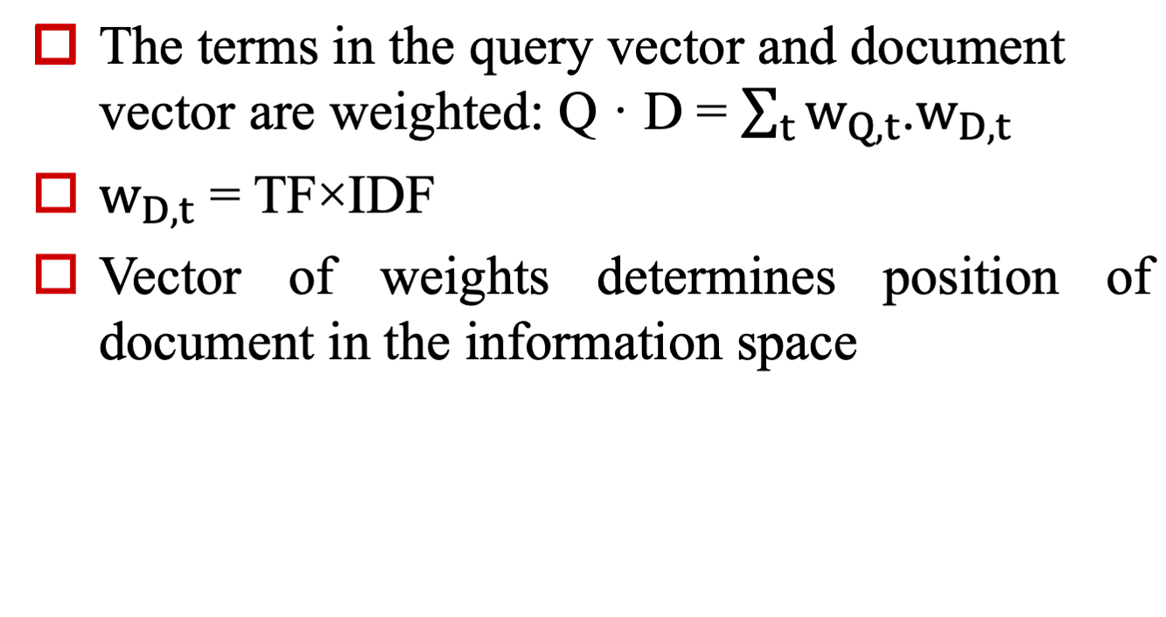
Vector Space Similarity
UIT, VNU-HCM
Social Media Analysis

Slide 22
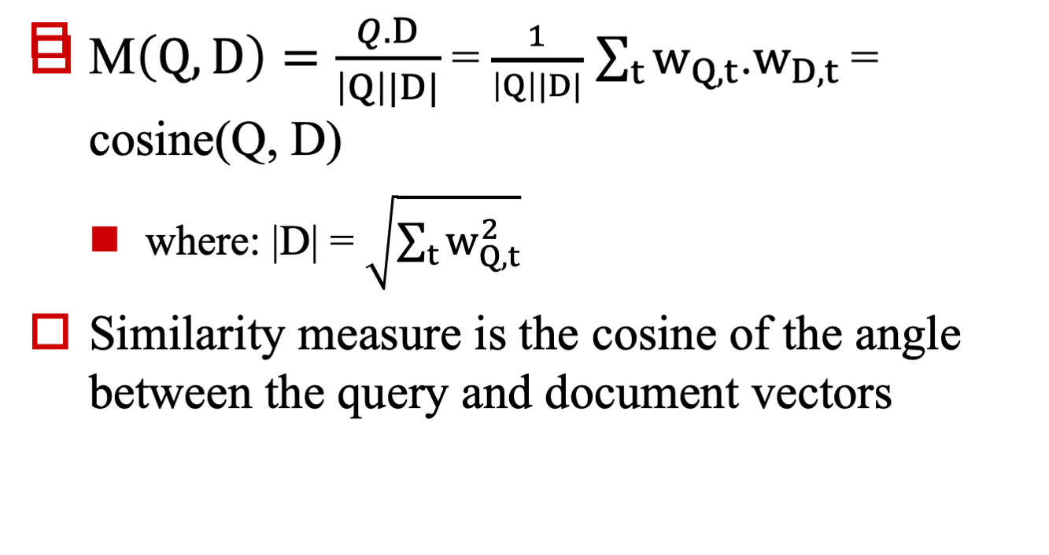
Vector Space Similarity
UIT, VNU-HCM
Social Media Analysis

Slide 23
Vector Space Similarity
TF is typically some monotonically increasing function of term frequency (similarly for IDF)
TF-IDF scheme determines units of each dimension in the information space
Many variants for calculating TF · IDF exist
(Salton and Buckley, 1988, in Sparck-Jones and Willett, eds.)
Alternative similarity measures to Cosine exist
Vector Space models perform extremely well for general document collections
UIT, VNU-HCM
Social Media Analysis

Slide 24
Language Understanding?
Want a system which “understands” documents and query and matches them?
  use semantic representation and logical inference
Until recently such technology was not robust / did not scale to large unrestricted text collections
But:
  useful for restricted domains
  now used for some large-scale tasks (QA, IE)
Is a “deep” approach appropriate for document retrieval?
  Powerset (Natural Language Search) think so (see www.powerset.com)
UIT, VNU-HCM
Social Media Analysis

Slide 25
Tasks in IR (broadly conceived)
Document Retrieval (ad-hoc retrieval)
Document Filtering or Routing
Document Categorization
Document Summarizing
Information Extraction
Question Answering
UIT, VNU-HCM
Social Media Analysis

Slide 26
Other Topics
Multimedia IR (images, sound, . . .)
  but text can be of different types (web pages, e-mails, . . .)
User-system interaction (HCI)
Browsing
UIT, VNU-HCM
Social Media Analysis

Slide 27
Evaluation
IR has largely been treated as an empirical, or engineering, task
Evaluation has played an important role in the development of IR
DARPA/NIST Text Retrieval Conference (TREC)
  began in 1992
  has many participants
  uses large text databases
  considers many tasks in addition to document retrieval
UIT, VNU-HCM
Social Media Analysis

Slide 28
IR in One Sentence
“Indexing, retrieving and organizing text by probabilistic or statistical techniques that reflect semantics without actually understanding”
(James Allan, Umass)
UIT, VNU-HCM
Social Media Analysis

Slide 29
Brief History of IR
1960s
  development of basic techniques in automated indexing and searching
1970s
  Development of statistical methods / vector space models
  Split from NLP/AI
  Operational Boolean systems
1980s
  Increased computing power
  Spread of operational systems
UIT, VNU-HCM
Social Media Analysis

Slide 30
Brief History of IR
1990s and 2000s
Large-scale full text IR systems for retrieval and filtering
Dominance of statistical ranking approaches
Web search
Multimedia and multilingual applications
Question Answering
TREC evaluations
UIT, VNU-HCM
Social Media Analysis

Slide 31
Brief History of IR
Course book
  Introduction to Information Retrieval
  Manning, Raghavan, Schu ̈tze http://nlp.stanford.edu/IR-book/html/htmledition/irbook.html
UIT, VNU-HCM
Social Media Analysis

Slide 32
Q&A
UIT, VNU-HCM
Social Media Analysis

Slide 33
  Thank you!
UIT, VNU-HCM
Social Media Analysis

